Slide 1
Hadoop Streaming
Hadoop Streaming is a utility that comes with the Hadoop distribution. It can be used to execute programs for big data analysis. Hadoop streaming can be performed using languages like Python, Java, PHP, Scala, Perl, UNIX, and many more. The utility allows us to create and run Map/Reduce jobs with any executable or script as the mapper and/or the reducer.
See example

Slide 2
How streaming works
Both the mapper and the reducer are python scripts that read the input from standard input and emit the output to standard output. The utility will create a Map/Reduce job, submit the job to an appropriate cluster, and monitor the progress of the job until it completes.
When a script is specified for mappers, each mapper task will launch the script as a separate process when the mapper is initialized. As the mapper task runs, it converts its inputs into lines and feed the lines to the standard input (STDIN) of the process. In the meantime, the mapper collects the line-oriented outputs from the standard output (STDOUT) of the process and converts each line into a key/value pair, which is collected as the output of the mapper. By default, the prefix of a line up to the first tab character is the key and the rest of the line (excluding the tab character) will be the value. If there is no tab character in the line, then the entire line is considered as the key and the value is null. However, this can be customized, as per one need.

Slide 3
How streaming works
When a script is specified for reducers, each reducer task will launch the script as a separate process, then the reducer is initialized. As the reducer task runs, it converts its input key/values pairs into lines and feeds the lines to the standard input (STDIN) of the process. In the meantime, the reducer collects the line-oriented outputs from the standard output (STDOUT) of the process, converts each line into a key/value pair, which is collected as the output of the reducer. By default, the prefix of a line up to the first tab character is the key and the rest of the line (excluding the tab character) is the value. However, this can be customized as per specific requirements.

Slide 4
mrjob
mrjob is a Python MapReduce library, created by Yelp, that wraps Hadoop streaming, allowing MapReduce applications to be written in a more Pythonic manner.
MRJob you write your jobs as classes and you don’t have to worry (as much) about the actual “streaming” nature of your job. MRJob handles key/value serialization/deserialization. It also comes with a variety of useful wrappers that allow for submitting jobs in a much cleaner than with the STDIN/STDOUT based approach.
mrjob allows MapReduce applications to be written in a single class, instead of writing separate programs for the mapper and reducer.
mrjob applications can be executed and tested without having Hadoop installed, enabling development and testing before deploying to a Hadoop cluster.
slow

Slide 5
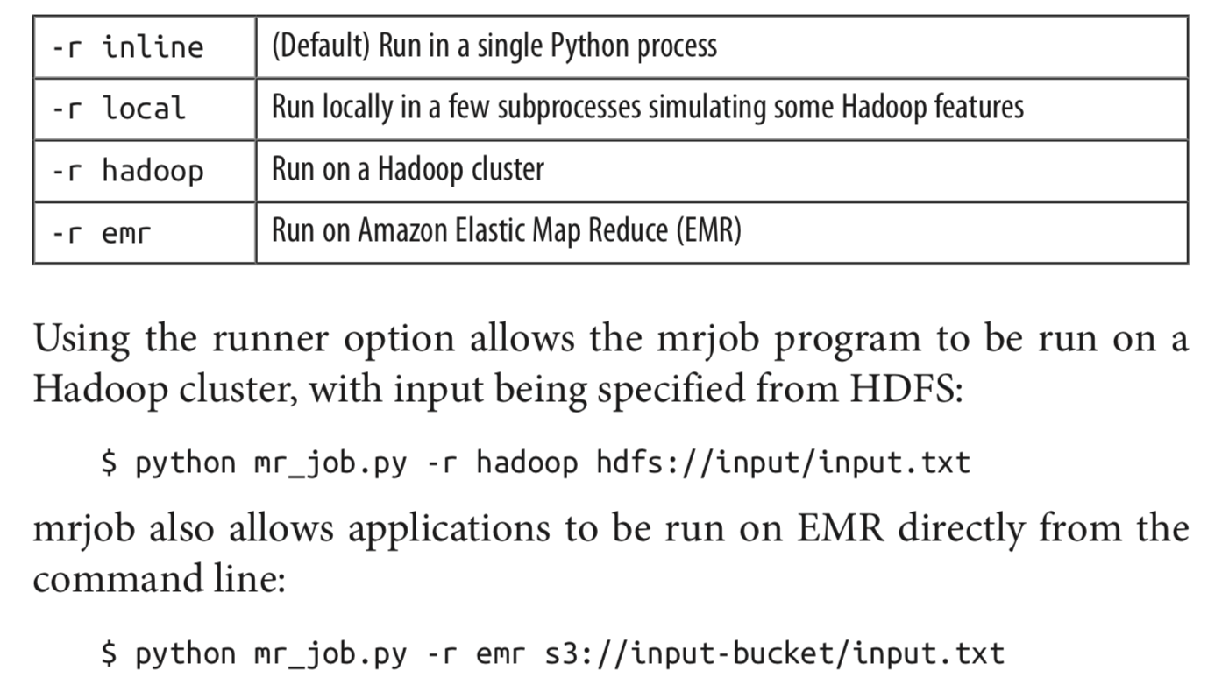
mrjob runner choices
See example

